Slide 1


Laravel 11
Instalasi Laravel di Linux

Slide 2
Apa saja yang dibutuhkan?
PHP >= 8.0
Server
Composer
Database (Mysql, MariaDB/ Postgree)

Slide 3
Atau install langsung
PHP >= 8.0
Server
Composer
Database (Mysql, MariaDB/ Postgree)

Slide 4
Laravel
Install satu paket Laravel:
>> /bin/bash -c "$(curl -fsSL https://php.new/install/linux/8.4)"
Install pakai composer:
>> composer global require laravel/installer

Slide 5

PHP
>> sudo apt install php
>> php -v
PHP 8.2.27 (cli) (built: Dec 24 2024 06:20:41) (NTS)
Copyright (c) The PHP Group
Zend Engine v4.2.27, Copyright (c) Zend Technologies
with Zend OPcache v8.2.27, Copyright (c), by Zend Technologies

Slide 6
Server
>> sudo apt install apache2
>> apache2 -v
Server version: Apache/2.4.62 (Debian)
Server built: 2025-01-16T08:42:04

Slide 7
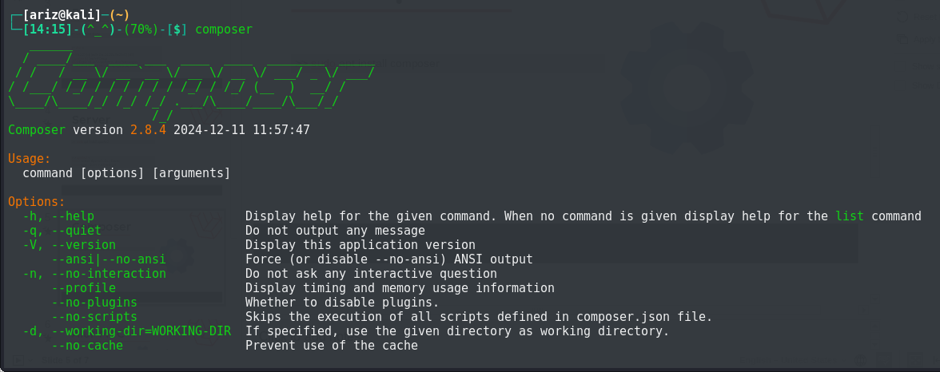
Composer
>> sudo apt install composer

Slide 8
Database
>> sudo apt install mariadb-client mariadb-server
>> sudo systemctl start mysql
>> sudo systemctl enable mysql
>> mariadb
Welcome to the MariaDB monitor. Commands end with ; or \g.
Your MariaDB connection id is 33
Server version: 11.4.3-MariaDB-1 Debian n/a
Copyright (c) 2000, 2018, Oracle, MariaDB Corporation Ab and others.
Support MariaDB developers by giving a star at https://github.com/MariaDB/server
Type 'help;' or '\h' for help. Type '\c' to clear the current input statement.

Slide 9
Laravel 11
Setup Laravel

